Slide 1
Artificial Intelligence Project
RA1911033010125 (Surbhit Pratik)
RA1911033010117(Keshav G Adkar)
RA1911033010103(Yash Bobde)

Slide 2
Car Price Prediction Model
About
This project predicts the price of a car using the dataset which contains car brand, year of purchase, KMs driven, number of previous owners
This is a very helpful tool for people who have a used car and want to know the actual value of the car and not be deceived by the lowered price offered at most retailers or traders

Slide 3
Problem Statement
An Indian automobile company Horizon MotoCorp aspires to enter the US market by setting up their manufacturing unit there and producing cars locally to give competition to their US and European counterparts.
They have contracted an automobile consulting company to understand the factors on which the pricing of cars depends. Specifically, they want to understand the factors affecting the pricing of cars in the American market, since those may be very different from the Indian market. The company wants to know:
Which variables are significant in predicting the price of a car
How well those variables describe the price of a car based on various market surveys, the consulting firm has gathered a large dataset of different types of cars across the American market.

Slide 4
Business Model
You are required to model the price of cars with the available independent variables. It will be used by the management to understand how exactly the prices vary with the independent variables. They can accordingly manipulate the design of the cars, the business strategy etc. to meet certain price levels. Further, the model will be a good way for management to understand the pricing dynamics of a new market.

Slide 5
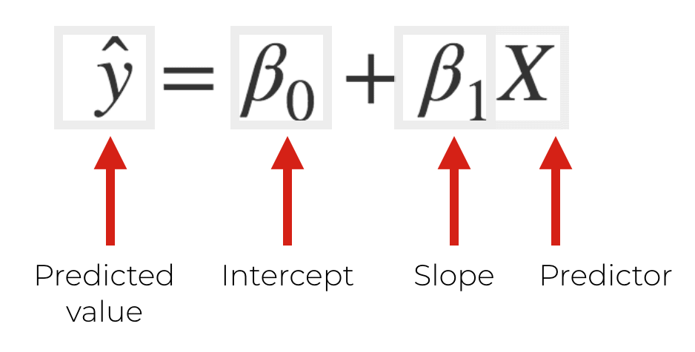
Algorithms Used
Linear Regression
It is a machine learning algorithm based on supervised learning. Regression models a target prediction value based on independent variables. It is mostly used for finding out the relationship between variables and forecasting.
Equation :

Slide 6
Algorithms Used
2. Lasso Regression
The word “LASSO” stands for Least Absolute Shrinkage and Selection Operator. It is a statistical formula for the regularisation of data models and feature selection.
When the predictor variables are highly correlated then multicollinearity can become a problem. This can cause the coefficient estimates of the model to be unreliable and have high variance. That is, when the model is applied to a new set of data it hasn’t seen before, it’s likely to perform poorly.
It helps in reducing irrelevant dimensions.
Equation : Standard Squared Error + λ|m| (Manhattan Distance is used)
(penalty factor)

Slide 7
Features
name
year
selling_price
km_driven
fuel
seller_type
transmission
owner

Slide 8
Societal Benefit
Since the manufacturers would be able to sell the car at a cost efficient price, the consumers would also be receiving a better value for money. This model can also be used by people who are looking to sell their old cars and receive the maximum resale value. In general, selling or buying a car is a exhausting job but with our model, the same process could be done within minutes instead of getting multiple car inspections at different retailers.

